Slide 1
Threat Feed Aggregator
Empowering Cybersecurity Professionals with Real-Time Threat Feeds

Slide 2
Background
The cybersecurity landscape is constantly evolving, with new threats and vulnerabilities emerging daily. Security professionals and enthusiasts need to stay informed, but the sheer volume of information can be overwhelming. RSS feeds from reputable sources like IBM X-Force Exchange, The Hacker News, and CISA (Cybersecurity and Infrastructure Security Agency) offer valuable insights, but manually checking multiple sources is time-consuming and inefficient.

Slide 3
Problem Statement
Information overload in cybersecurity
Time Constraints for checking multiple sources.
Lack of centralized, mobile-friendly platform.

Slide 4
Project Objectives
To develop an Android application that efficiently aggregates and presents RSS feeds from IBM X-Force Exchange, The Hacker News, and CISA, providing users with a centralized platform for accessing cybersecurity news and threat intelligence.
To create a user-friendly interface for browsing aggregated cybersecurity RSS feeds on Android devices.
To implement efficient RSS parsing and storage mechanisms to ensure quick access to the latest information.
To provide customization options, allowing users to prioritize feeds and filter content based on their specific interests or needs.
To enhance the overall user experience through features such as offline reading, push notifications for critical updates, and easy sharing capabilities.

Slide 5
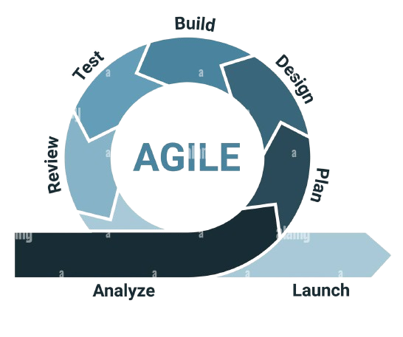
Agile Methodology
Flexibility: Adapts to changing requirements and continuous user feedback.
Incremental Delivery: Regularly delivers small, functional segments for testing and improvement.
Efficiency: Enhances productivity with iterative cycles and frequent reassessments.

Slide 6
System Architecture
High-Level Design
Components and Their Functions:
Data Ingestion Layer
Data Processing Layer
User Interface Layer
Ingestion Engine: Collects and pre-processes data
Analysis Engine: Analyses data and generates insights
Dashboard: Displays real-time information and alerts

Slide 7
Features of the Application
Key Functionalities:
Aggregation of feeds from IBM X-Force Exchange, The Hacker News, and CISA
User-friendly interface with Material Design
Offline access to threat data
Push notifications for critical updates

Slide 8
Challenges and Solutions
Problems Faced:
How They Were Overcome:
Data inconsistency from different sources
High volume of data processing
Implemented data normalization techniques
Optimized data processing algorithms

Slide 9
Conclusion and Future Work
Future Enhancements
Expand data sources for more comprehensive coverage
Integrate advanced machine learning models for predictive analysis
Develop mobile applications for on-the-go monitoring

Slide 10
THE END

